Slide 1
Applications of cognitivist learning on instructional technology
By Kago Desmond Monare

Slide 2
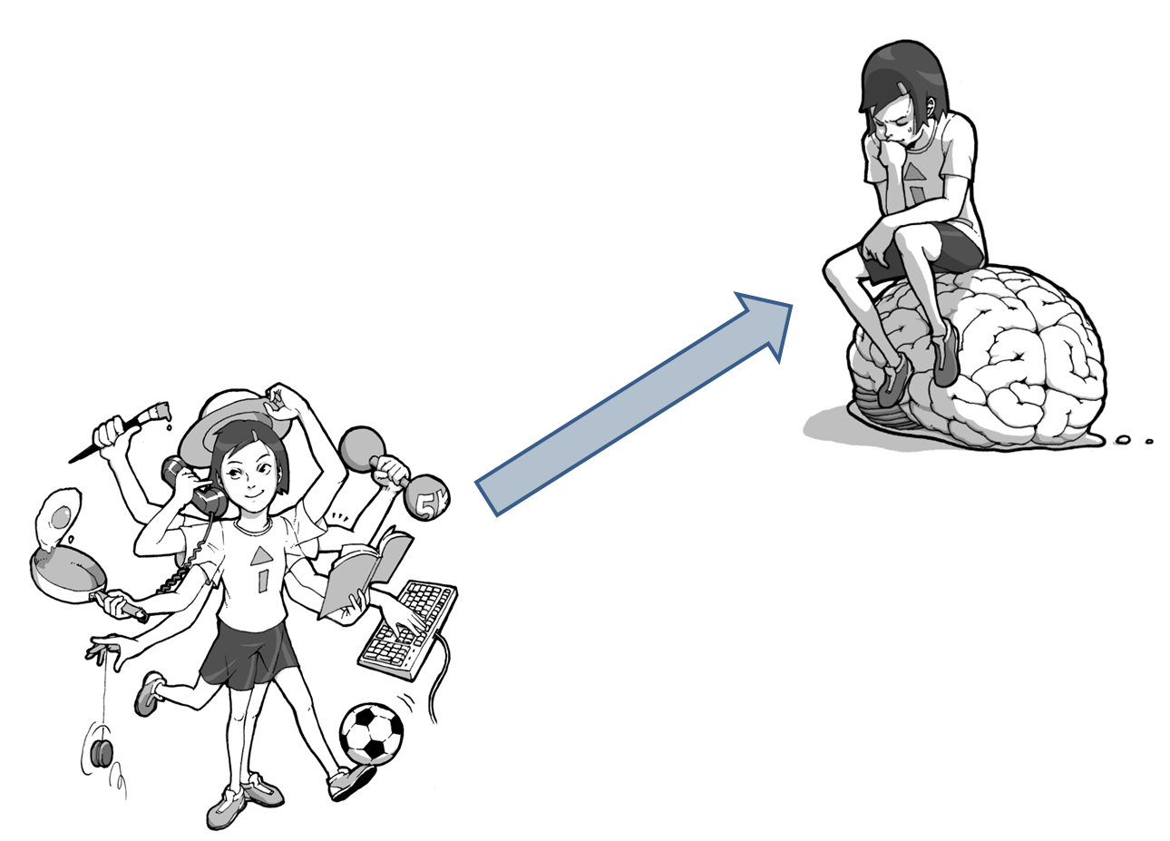
What is Cognitivism
This is the ability for human to think and adapt mentally to different environments and situations. This ability differentiates us from animals. It is way where by many psychologists and researchers have proposed theories on thought and how humans learn.
These process is an active action by
human beings become eager
and seek out knowledge
and understanding.

Slide 3
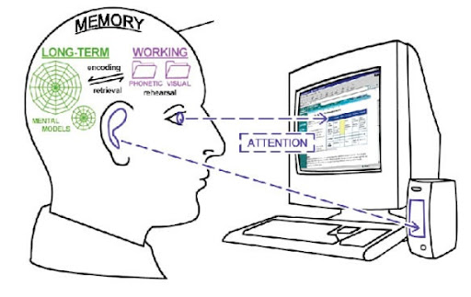
Cognitivism & Technology
Cognitivism began influencing technology in education in the 1970’s. Its adoption led to a shift from measuring external behavior to focusing on the internal mental processes behind behavior, leading to a greater emphasis on task- and learner analysis.
According to Cognitivists, tasks are broken down to move from simple to complex, based on previously-learned mental models, or schema. Cognitivism is currently the principal theory used in instructional design (http://michaelhanley.ie/elearningcurve/tag/cognitivism/page/3/).

Slide 4
Computer technology
Cognitive tools help learners with complex cognitive learning activities and critical thinking. These tools are learner controlled in the sense that they construct their knowledge themselves using the tools rather than memorizing knowledge. In this perspective, computer systems are "partners" that stimulate learners or groups of learners to make maximum use of their cognitive potential ( http://edutechwiki.unige.ch/en/Cognitive_tool).

Slide 5
Computer technology
Computers are widely used as part of instructional technology and this kind of technology can be seen as cognitive tool that represent a significant move from traditional way of despising information to learners.
In cognitive tools, information and intelligence is not encoded in the educational communications which are designed to efficiently transmit that knowledge to the learners. With cognitive tools, the traditional design and development processes are eliminated (Jonassen, 2009).

Slide 6

Computer technology
Using computer technology learners have to think about what they are learning or applying, if the learners decide to use these tools to assist them learn, then the tools will facilitate their learning process.

Slide 7
E-learning
Cognitive theories have been used to support the theory that Instructional Technology (IT) is most successful when it involves synchronous rather than asynchronous communications between student and teacher. Cognitive theories of learning have been used to establish that interactive IT is the method that will most likely increase learning (http://jmajor.midsolutions.org/).
Instructional technology is applied mostly on E-learning as platform application. This allows learners to be interactive an be able to communicate between instructor and learner.

Slide 8

Knowledge Integration
Cognitive tools have a big role in how we learn and how IT is a platform of information dissemination. Online discussions (forums), Teleconferences, Video streaming (youtube, etc). Such tools mentioned allow learners to connect new information to prior knowledge therefore,
learners are building a larger array of information from all over, as the world has become a global village information can be shared easily and collaborative work can be achieved.

Slide 9
Conclusion
Cognitive learning applications on instructional technology have a big role in how we learn and they encourage and develop ability for learners to think and process information.
This knowledge would contribute vital information for further quests in understanding the online modality of education and therefore help to both lower attrition rates and increase the design of instructionally sound web-based courses (Miltiadu, M & Savenye, 2003, pg 24).

Slide 10
Reference
EduTech Wiki. Cognitive tool. Retrieved from http://edutechwiki.unige.ch/en/Cognitive_tool
Hanley, M. Discovering Instructional Design, Part 1. Retrieved from http://michaelhanley.ie/elearningcurve/tag/cognitivism/page/3/
Jonassen, D.H. 2009. Technology as Cognitive Tools: Learners as Designers. ITForum Paper #1. Retrieved from http://it.coe.uga.edu/itforum/paper1/paper1.html
Miltiadu, M & Savenye, W. C. 2003. Applying Social Cognitive Constructs of Motivation to Enhance Student Success in Online Distance Education
Rose Colored Glasses, Random Thoughts on Instructional Design. Cognitivism and Online Learning. Retrieved from http://jmajor.midsolutions.org/?p=7

